Slide 1

Comp 693 Industrial Project
Residential Sales Price Analysis for Christchurch
(Research Project)
Student Name: Junhua Tang
Student ID:1161432
Presented on: 3rd Nov, 2025

Slide 2

/
01
Introduction

Slide 3



Background
Overview
This research investigates how liquor store proximity affects housing prices in Christchurch.
Uses spatial analysis to explore spatial correlation and influence extent.
Housing prices are affected by many factors (e.g., area, location, layout), but liquor store proximity is rarely studied.
The project was initiated by David Dyason, Lincoln University.
Problem Statement
It is unclear whether housing prices in Christchurch show spatial correlation. If the Moran’s I is close to 0, further spatial modelling would not be meaningful.
The impact of liquor store proximity on housing prices is still unknown. A suitable quantitative model is needed to measure this.
Project Team
Mentor: David Dyason
Owner of Project: Junhua Tang

Slide 4

/
02
Goals & Requirements

Slide 5
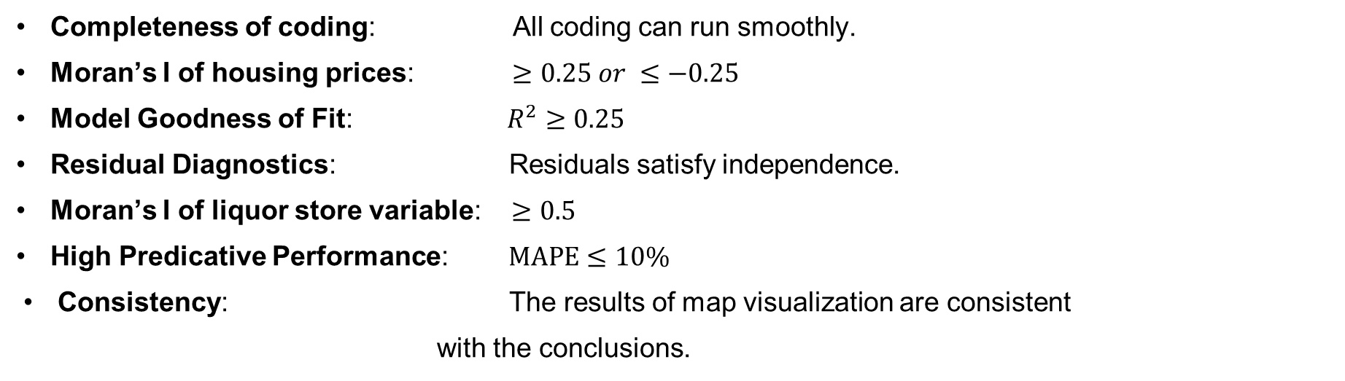
Goals & Requirements
Overall Goal
Find an appropriate model to indicate the impact of liquor store proximity in quantitative terms.
Subgoals
Completeness of coding: All coding can run smoothly.
Moran’s I of housing prices: $≥0.25 or ≤−0.25$
Model Goodness of Fit: $R^{2}≥0.25$
Residual Diagnostics: Residuals satisfy independence.
Moran’s I of liquor store variable: $≥0.5$
High Predicative Performance: $MAPE≤10\%$
Consistency: The results of map visualization are consistent with the conclusions.

Slide 6


/
03
Methods

Slide 7
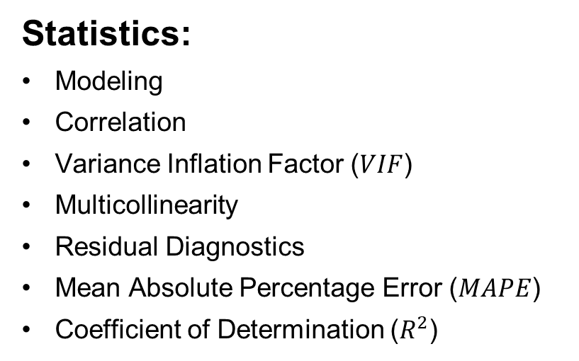
Overview of Method
Statistics
GIS
Python
Statistics:
Modeling
Correlation
Variance Inflation Factor ($VIF$)
Multicollinearity
Residual Diagnostics
Mean Absolute Percentage Error ($MAPE$)
Coefficient of Determination ($R^{2}$)
Python:
Jupyter
Numpy
Pandas
Matplotlib
Geopandas
Shapely
Esda.Moran
Mgrw.gwr
Sklearn
Statsmodels.
Scipy
GIS:
Moran’s I
Map layers
Geographically Weighted Regression (GWR)
Spatial Data Analysis
Spatial visualization/Mapping
Spatial Data Processing/transformation

Slide 8
Design
Data Collection
Data Processing
New Variable Introduction
Map Visualization
Moran’s I
Correlation Between Variables
Test for Multicollinearity
Modelling
Modeling Analysis
Visualization of Coefficient
Residual Diagnostics
Evaluation of Predictive Performance
Summary & Conclusion
Equation of Model

Slide 9
Risks and Challenges
Abnormal Data Handling
Difficulty in detection
Large amount of abnormal
Affect model
Affect accuracy

Slide 10
Risks and Challenges
Goodness of Fit
Current variable insufficient to uncover all information of data
Residual Diagnostics indicated no independence.

Slide 11




Result &
Outcomes

Slide 12
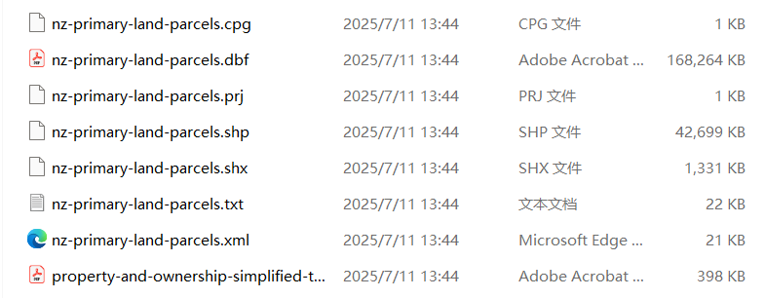
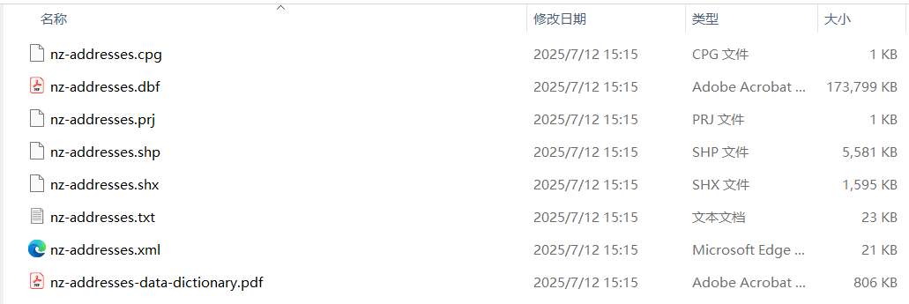
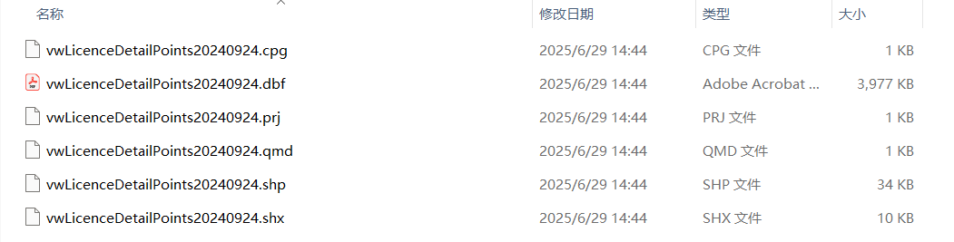
Data Collection

Slide 13
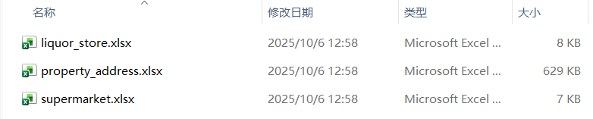
Data Processing

Slide 14
Map Visualization

Slide 15
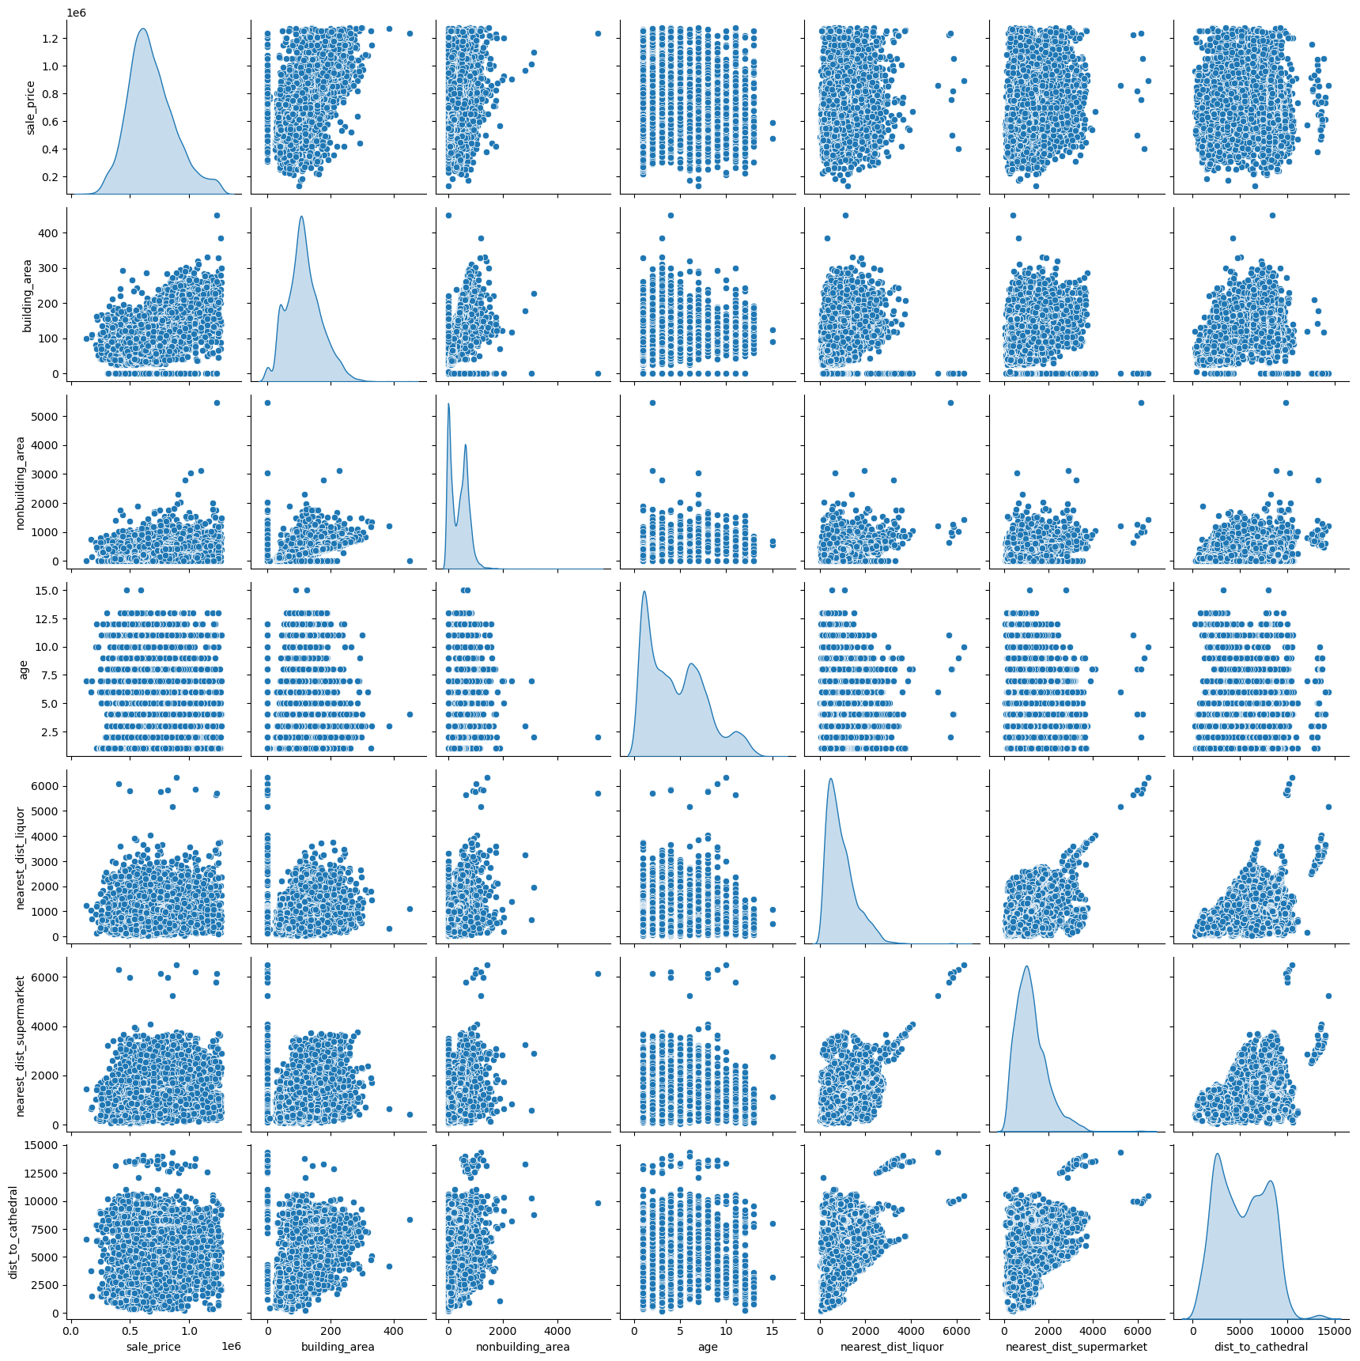
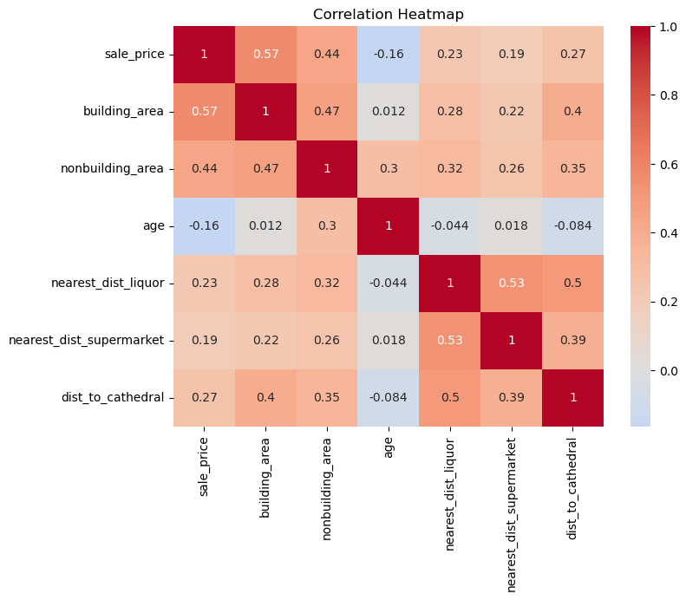
Correlation

Slide 16
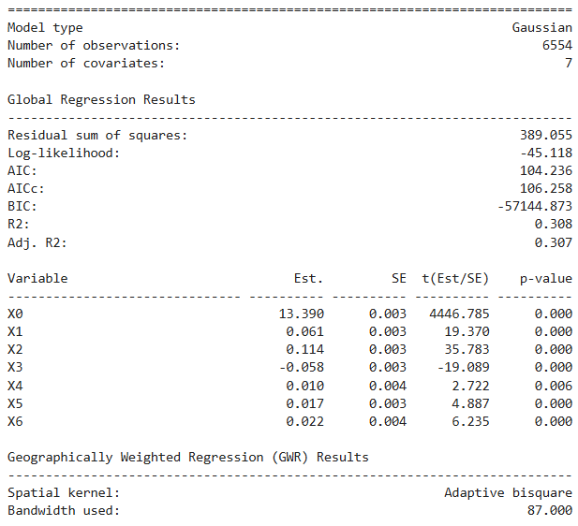
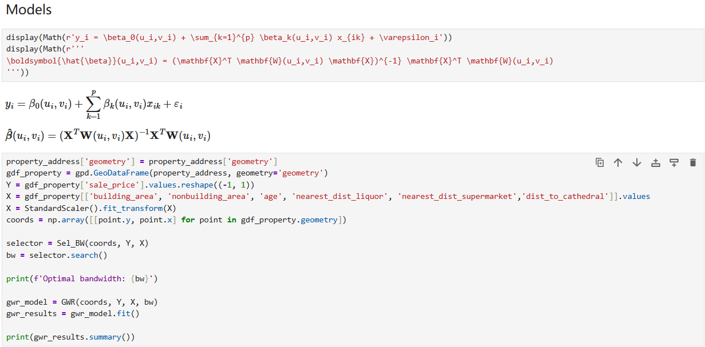
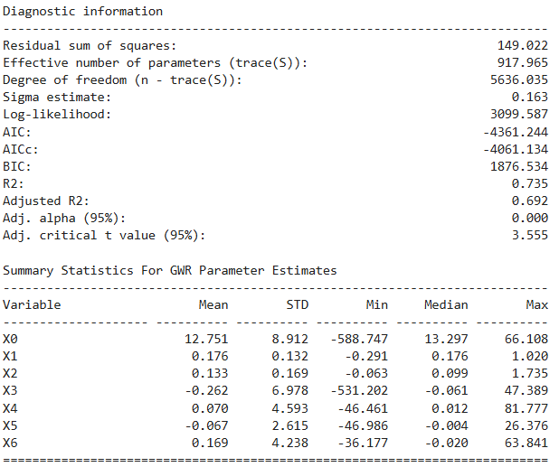
Modeling

Slide 17
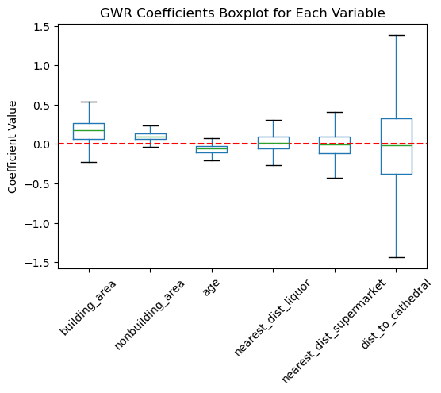
Boxplot of Coefficient

Slide 18
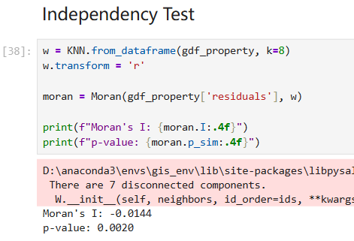
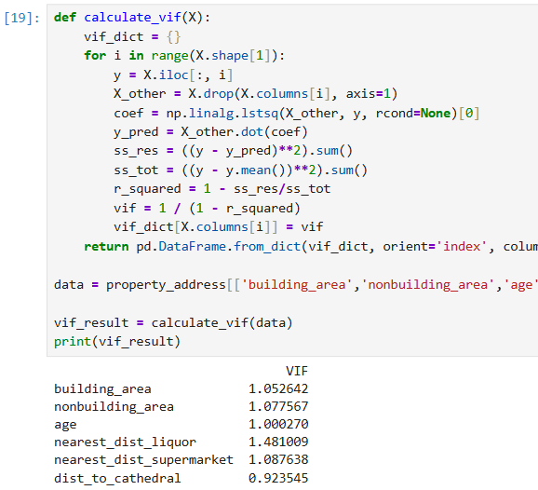
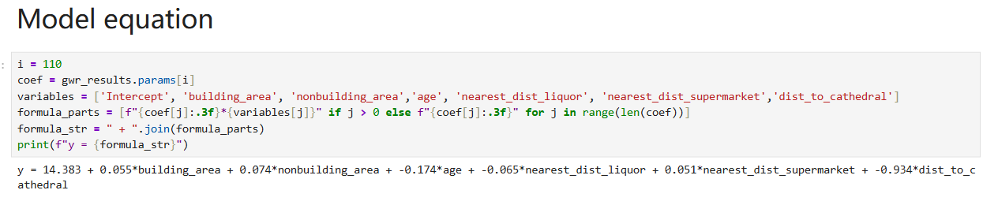
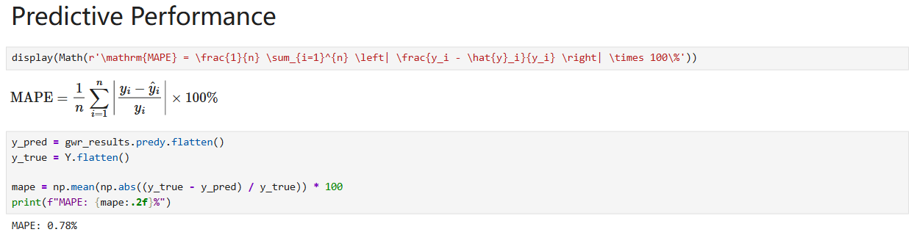
Test & Validation

Slide 19
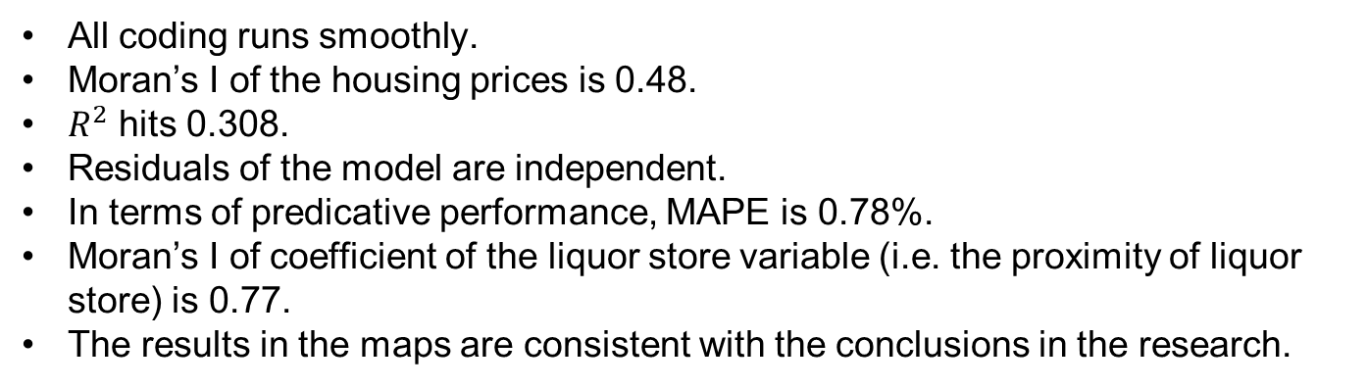
Reflections
The overall goal and all subgoals are achieved
All coding runs smoothly.
Moran’s I of the housing prices is 0.48.
$R^{2}$ hits 0.308.
Residuals of the model are independent.
In terms of predicative performance, MAPE is 0.78%.
Moran’s I of coefficient of the liquor store variable (i.e. the proximity of liquor store) is 0.77.
The results in the maps are consistent with the conclusions in the research.
Extension of Learning
GIS spatial data analysis
GIS libraries in Python
Data Analysis suing Python
Statistical Model (GWR)

Slide 20
Conclusions
On the whole, the result of research shows that the proximity of liquor stores has no absolutely positive or negative influence on the housing price.
Locally, nevertheless, the impact of liquor stores proximity takes on a strong regional variation.

Slide 21
Strengths and Limitations
Strengths
Limitations
Low cost
High efficiency
New variable introduction
GWR v.s OLS
Difficulty in detection of Abnormal data
Large amount of abnormal
Affect model
Affect accuracy

Slide 22
Suggestions for Future
TGWR
Take into account of factor of sales date, try to use TGWR (Temporally Geographically Weighted Regression)
Web-scraping Techniques
Use web-scraping techniques to extract correct details of housing.
New Variable Introduction
Explore new variables and introduce them, like greens and educational institution.

Slide 23

Thank You
End

